Slide 1
Cache-Efficient Fork-Processing Patterns on Large Graphs
Paper Review // 6.5060 Algorithm Engineering

Slide 2
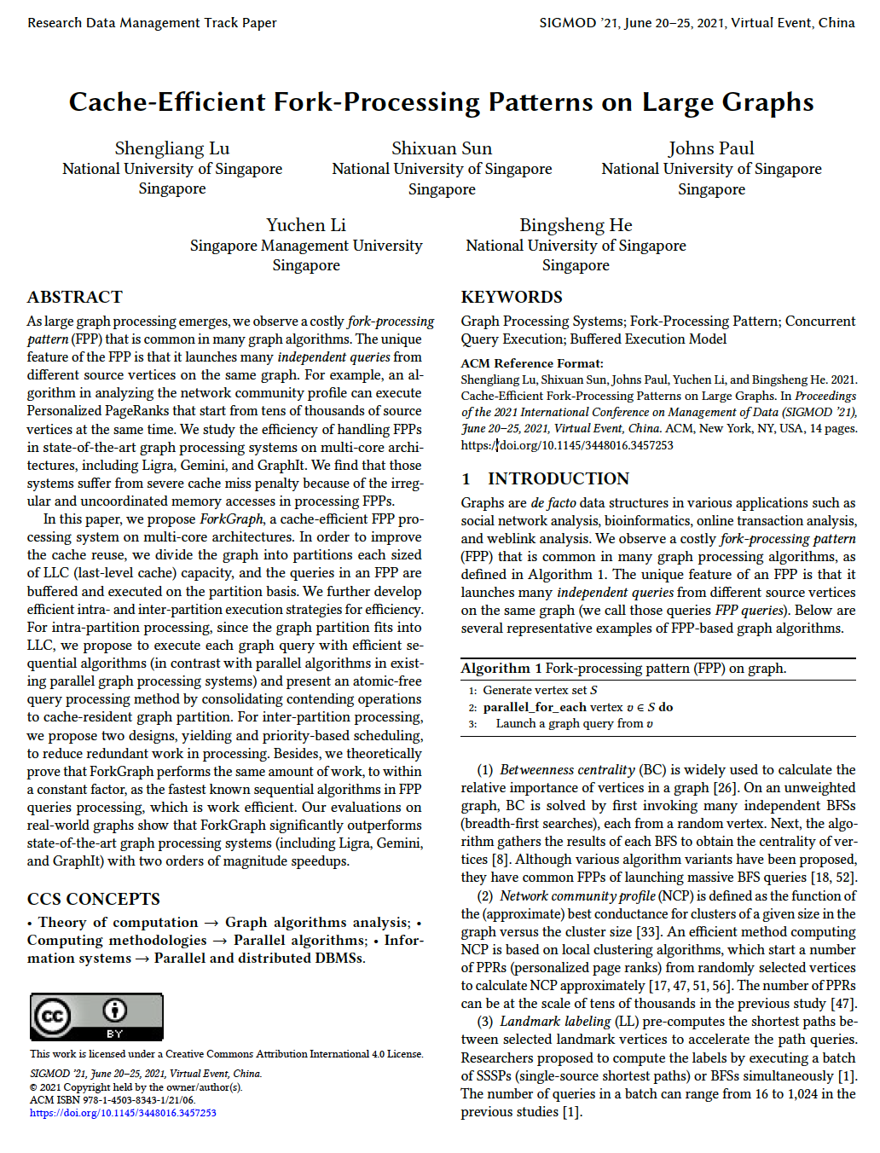







Cache-Efficient Fork-Processing Patterns on Large Graphs
Proceedings of the 2021 International Conference on Management of Data (SIGMOD ’21)
National University of Singapore

Slide 3

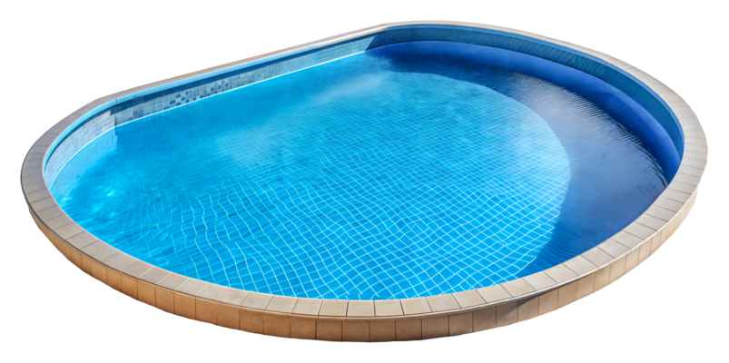
Cache-Efficient Fork-Processing Patterns on Large Graphs
Proceedings of the 2021 International Conference on Management of Data (SIGMOD ’21)
Proposed improvements:

Slide 4

Fork

Slide 5
ForkGraph

Slide 6
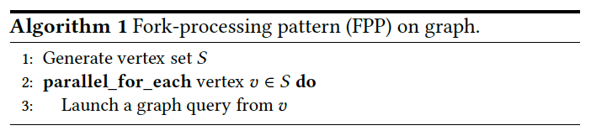
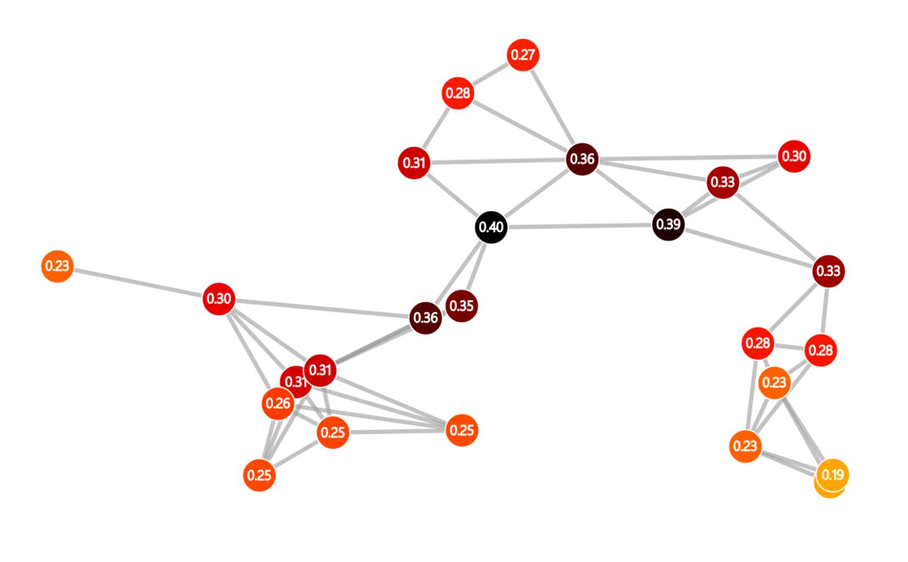
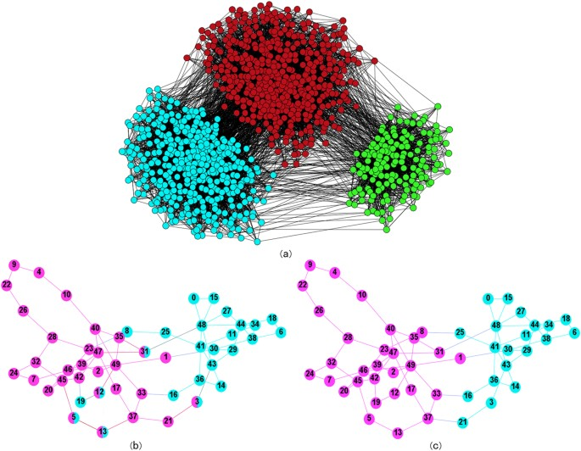
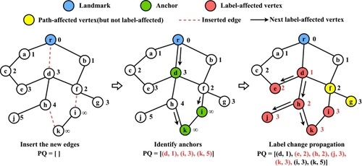
The Fork-Processing Pattern (FPP)
Many graph processing algorithms
look like this (also learning, mining)
Betweenness Centrality
Network Community Profile
Landmark Labeling
Many independent BFS
Multiple PPRs from randomly selected vertices
Multiple SSSP / BFS simultaneously in a batch
www.networkpages.nl
Finding Communities by their Centers, Chen et al.
FulBM: Fast Fully Batch Maintenance for Landmark-based 3-hop Cover Labeling, Zhang et al.

Slide 7
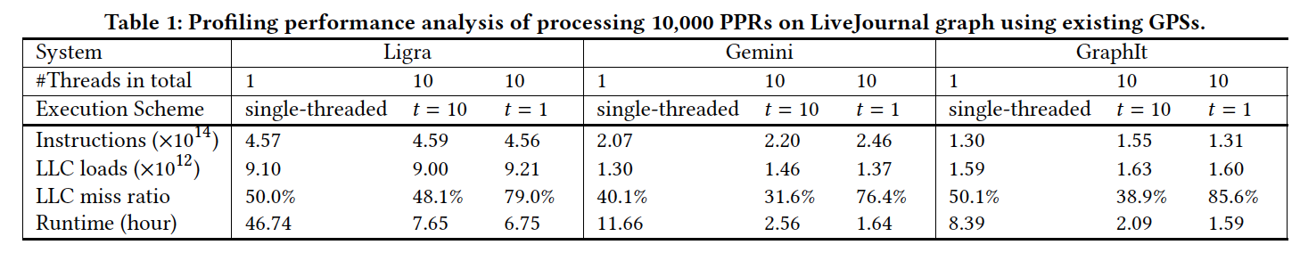
This leads to a tremendous amount of redundancy and LLC misses.
*t = number of threads assigned to a query
90% of processing time is FPP
LLC misses are the bottleneck 34-40% of time spent in memory units is stalled memory cycles from LLC misses 55% if t=1 (inter-query parallelism)

Slide 8
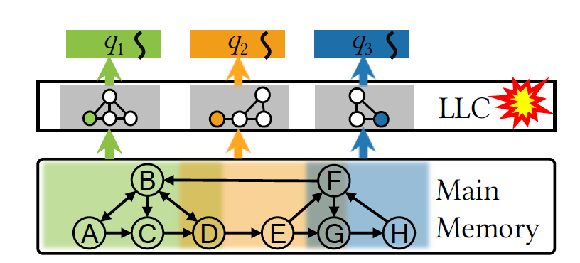
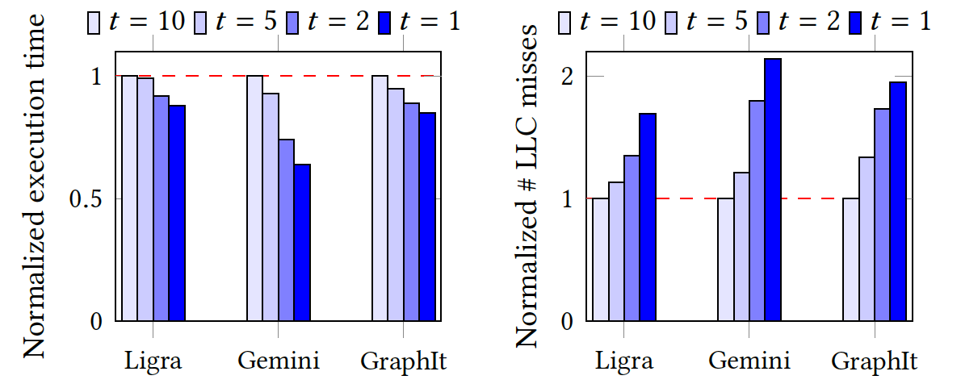
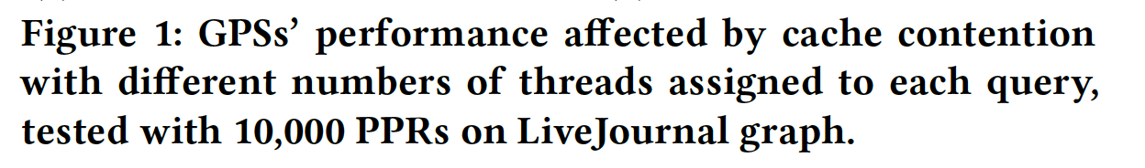
Where are the LLC misses coming from?
Inter-query
Each query q is processed separately
Uncoordinated cache use leads to thrashing
Bonus redundancies

Slide 9
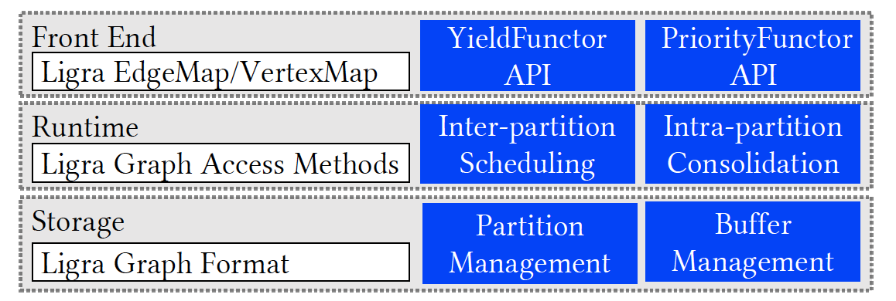
Existing Graph Processing Systems (2021)
Distributed graph processing system
Tested with message-passing functions disabled
State of the art DSL (domain specific language) Cache-optimized to break graph into LLC-
size segments and prevent random access within the cache. Not great for inter-query parallelism.
Fastest implementation, maintained
The authors <333 Ligra

Slide 10
ForkGraph (à la Ligra)
1. Full graph G is partitioned into LLC-size chunks
3. Queries are performed on the graph
2. Each partition is associated with a buffer for storing its operations
Operations from different queries are buffered by partition and executed in a batch
Naturally reduces LLC misses because each partition fits into cache
Consolidation
Intra-partition
Inter-partition
Operations from different queries are adjacent in the buffer and can be run without atomics
Queries can be sorted to prevent redundancies
Sequential implementations for multiple simultaneous operations
One-thread per buffered operation (effectively inter-query)
Need to decide which partitions to query in which order
Minimize redundant work across partitions

Slide 11
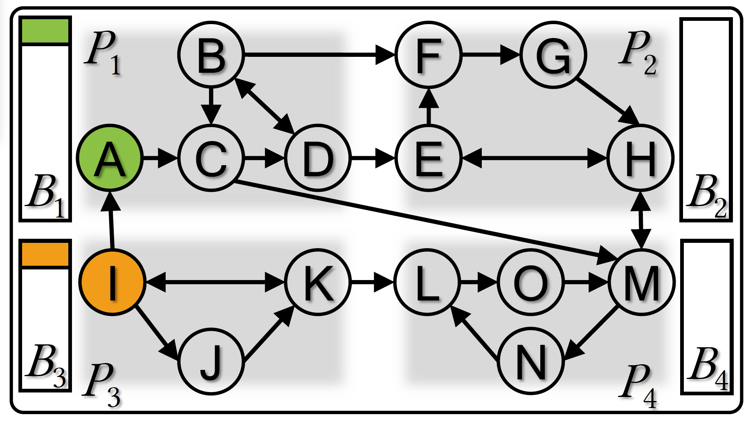
Challenges with intra- and inter-partition parallelism
Example problem on a
partitioned graph
(p.s. graph partitioning done using METIS)
Inter-
Multiple partitions processed independently
Poor cache-efficiency in existing GPSs
Memory-level parallelism
How to determine execution order?
Intra-
Multiple operations running simultaneously within a partition
Requires costly synchronization
How to make work-efficient?

Slide 12
Outstanding questions in intra- and inter-partition parallelism
Example problem on a
partitioned graph
(p.s. graph partitioning done using METIS)
Inter-
Multiple partitions processed independently
When to terminate processing in a given partition (yielding)
Which partition to go to next
Intra-
Multiple operations running simultaneously within a partition
Work-efficient sequential implementations for multiple operations simultaneously
Remove atomics through consolidation (query-centric) and sorting (remove redundancies by prioritizing)

Slide 13
ForkGraph’s approach to efficient parallelization
Parallel algorithms in existing GPS implementations require significant overhead (synchronization, locking, scheduling) and are not work efficient
ForkGraph proposes a cache-efficient intra-partition processing method
Parallelism on the level of individual queries, not partitions
Each thread retrieves from the buffer and processes the operations of a given query sequentially using known state-of-the-art sequential algorithms

Slide 14
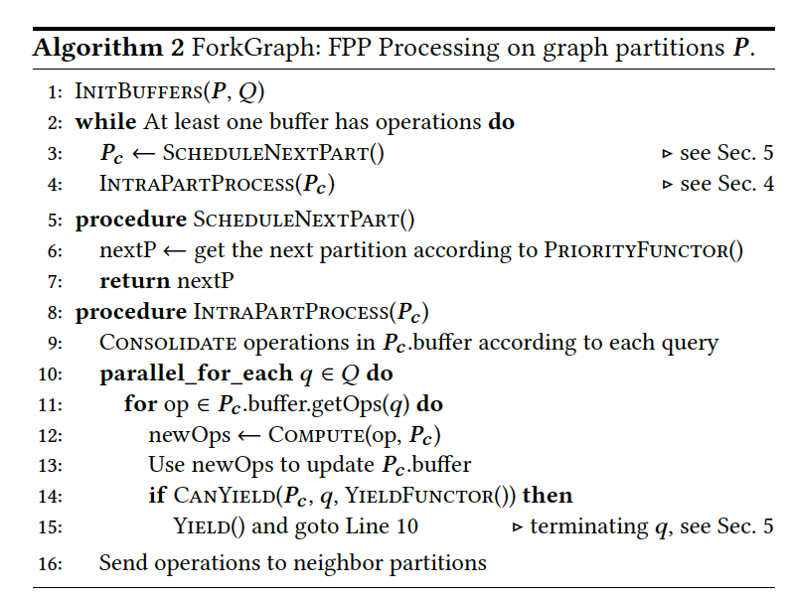
Execution flow
Graph has been pre-partitioned into P
Initialize buffers (dynamic sized, contiguous memory) + assign initial queries
While non-empty buffers exist:
Find the next partition to process
and process it
Consolidate the operations stored in that partition’s buffer by query and assign each query to a thread
Track newly generated operations and assign to own buffer to be processed (if internal to partition) or held in a local buffer (like an outbox)
Yield each query if it exceeds threshold (e.g. number of edges processed)
Local buffer gets distributed to other partitions’ buffers in batches at end of processing

Slide 15
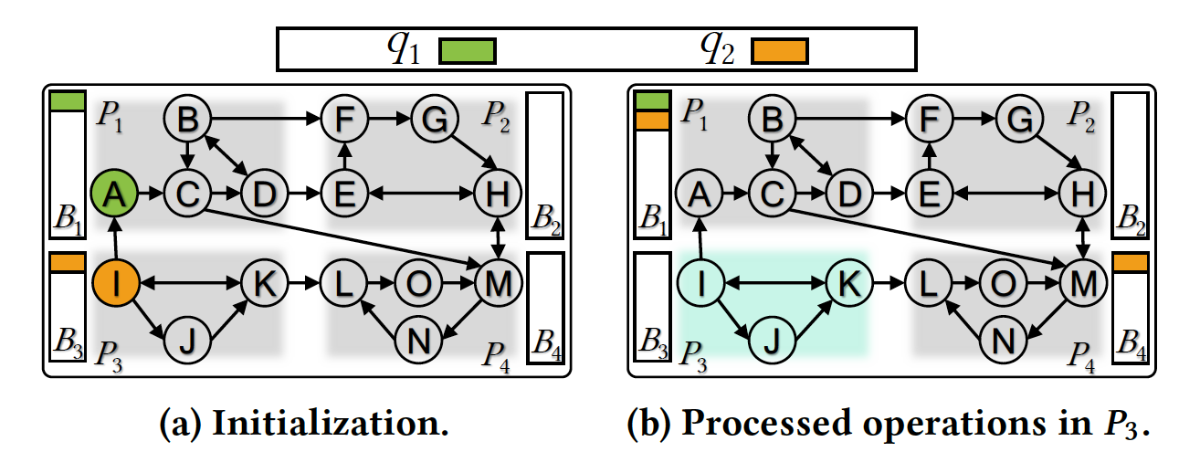
Execution flow
Graph has been pre-partitioned into P
Initialize buffers (dynamic sized, contiguous memory) + assign initial queries
While non-empty buffers exist:
Find the next partition to process
and process it
Consolidate the operations stored in that partition’s buffer by query and assign each query to a thread
Track newly generated operations and assign to own buffer to be processed (if internal to partition) or held in a local buffer (like an outbox)
Yield each query if it exceeds threshold (e.g. number of edges processed)
Local buffer gets distributed to other partitions’ buffers in batches at end of processing

Slide 16
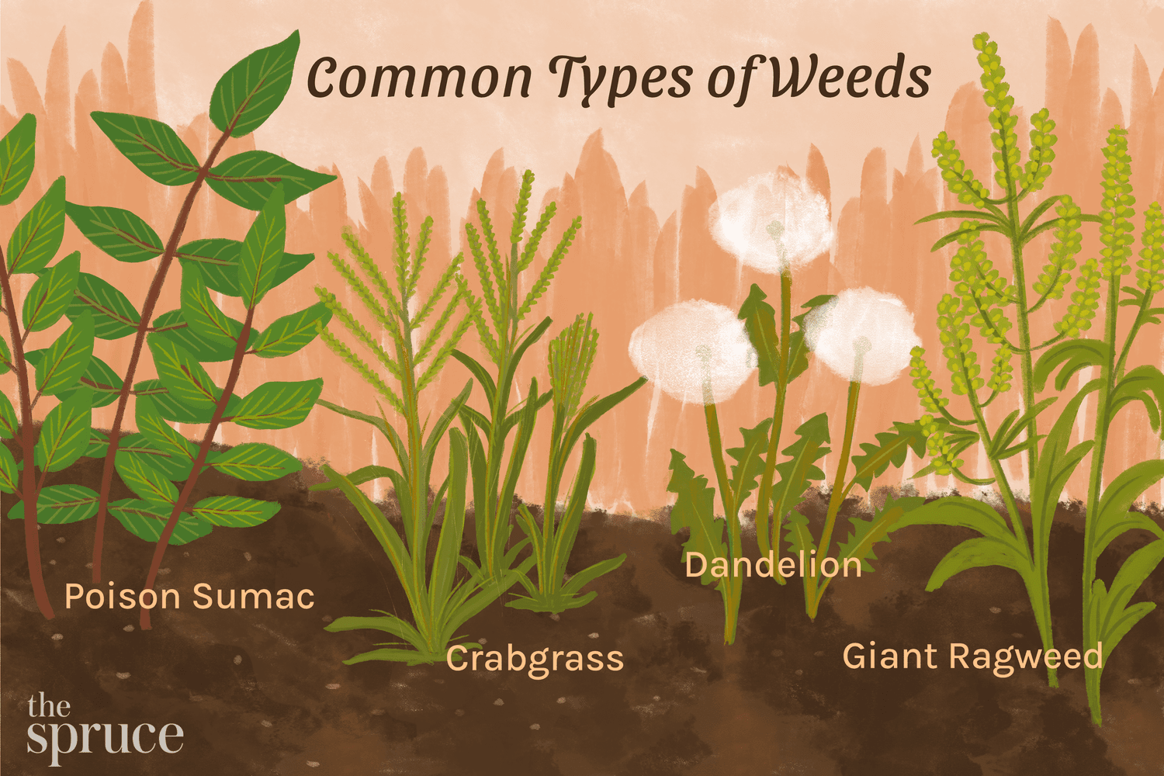
ForkGraph’s
what did they do to make this work?
Query-centric
operation consolidation
Heuristic-based yielding
Prioritizing consolidated
queries
Priority-based scheduling

Slide 17
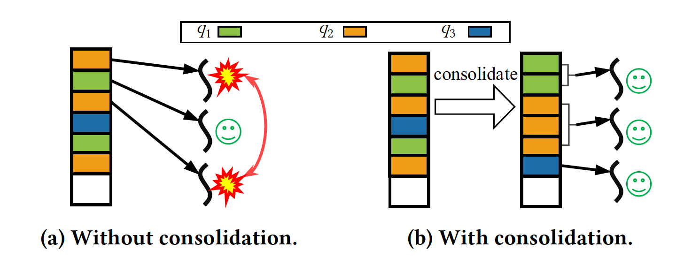
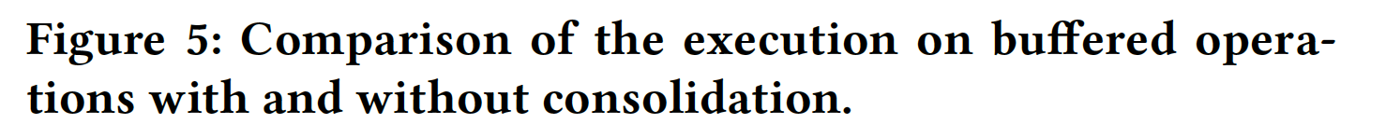
INTRA: Query-Centric Operation Consolidation
What is it?
Assign all operations from same FPP query to individual threads
Process all FPP queries in parallel
Why is it needed?
Access conflicts from different threads processing operations of same query simultaneously
Requires locking and synchronization operations (expensive)
What are the benefits?
Operations of one query can be sequential and atomic-free
Avoids stride memory access (query data is shared in contiguous memory space)

Slide 18
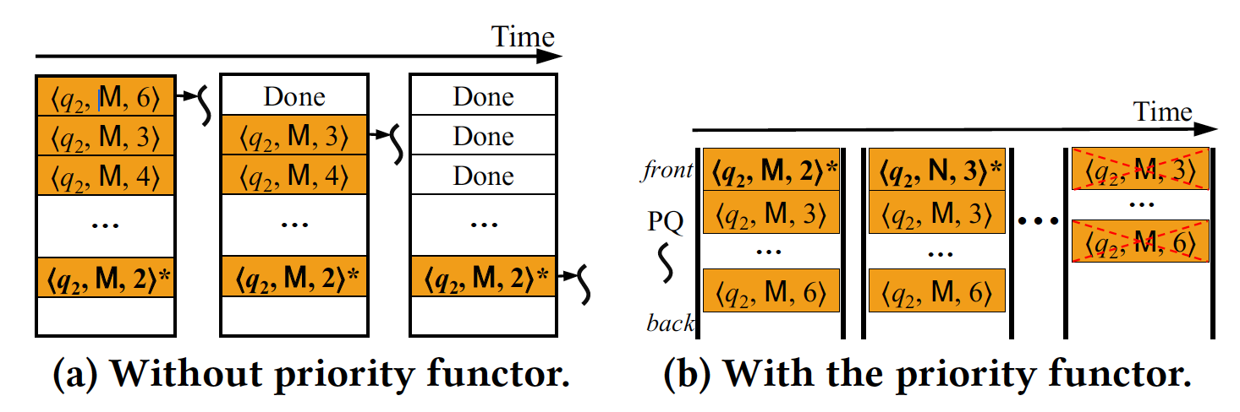
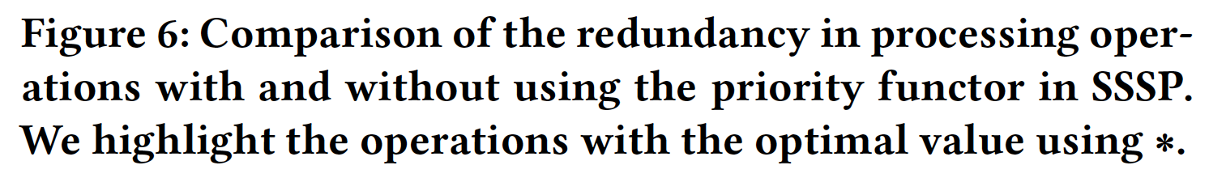
INTRA: Prioritizing Consolidated Queries
What is it?
Within each group of consolidated operations, order by priority
Priority functor is determined by user (established literature)
Why is it needed?
Redundant processing (e.g. exploring shorter paths before longer ones, then pruning)
What are the benefits?
Reduces the number of operations by prioritizing those most likely to converge

Slide 19
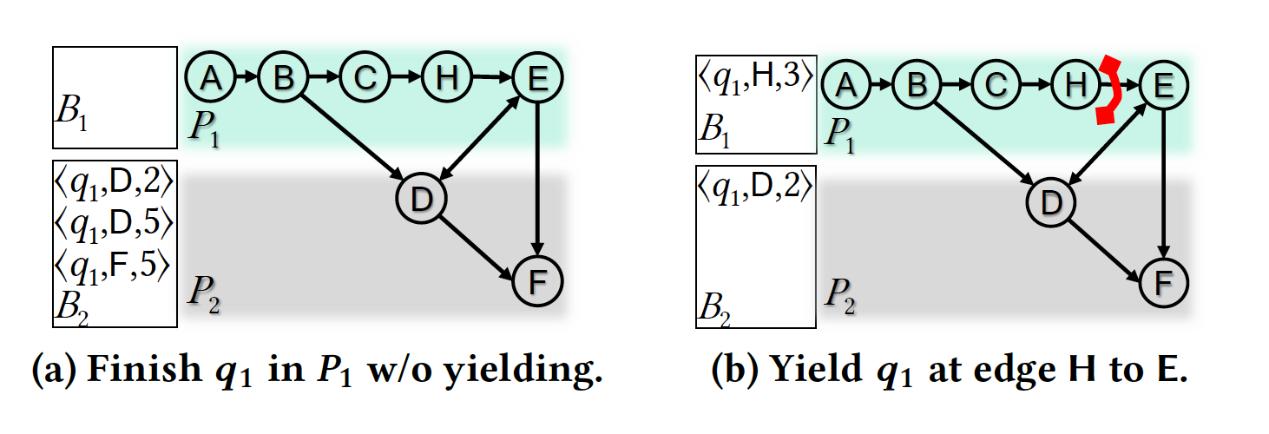
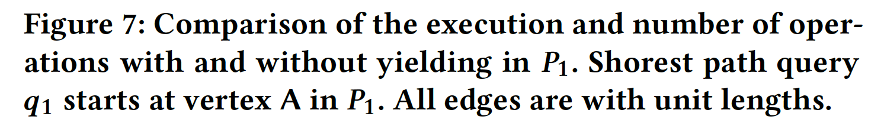
INTER: Heuristic-Based Yielding
What is it?
Pause running a query if it satisfies user-determined heuristics (will be processed later in the partition buffer)
Heuristics
Number of edges processed (too many?
Operations’ values updated (do they exceed a Delta range?)
Why is it needed?
Diminishing returns (e.g. PPR can converge to local stable states that are disrupted by external partitions; SSSP is more likely to spend time exploring unpromising paths if it stays within one partition)
What are the benefits?
Reduces redundant operations
Improves work efficiency of FPP operations

Slide 20
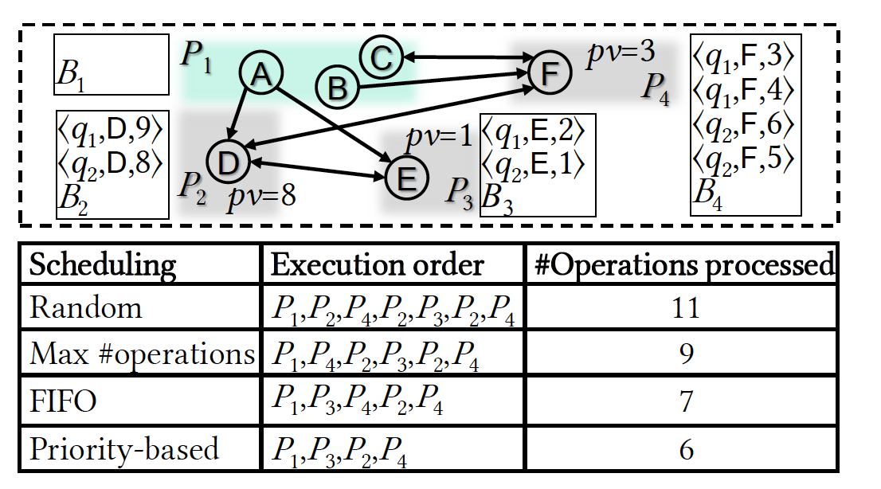
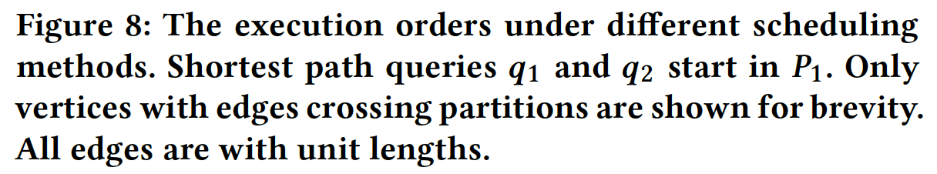
INTER: Priority-Based Scheduling
What is it?
A decision-making process for selecting the next partition by priority
Methods tested
Random (worst)
Max # of operations (maximize reuse of cache content? But more redundant…)
FIFO is default
Best is user-specified, algorithm-specific priority functors
Why is it needed?
Incorrect ordering of partitions makes it likely that you will repeatedly revisit the same partitions
Pick the partitions that are buffering the most promising operations for convergence
What are the benefits?
Reduces redundancy and accelerates convergence

Slide 21
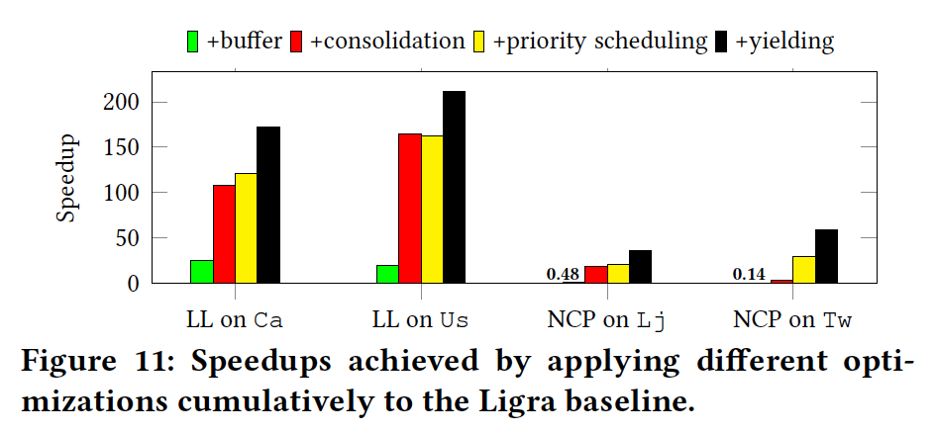
Effect of individual techniques*
Cuts the total number of operations
Negative performance improvements! Only finishing PPR query when complete in partition, which is highly redundant.
Reduces memory overhead and atomic operations
*can be further improved by parameter tuning of yielding conditions

Slide 22

Experimental Evaluation
EXISTING GPSs
FORKGRAPH
Disney

Slide 23
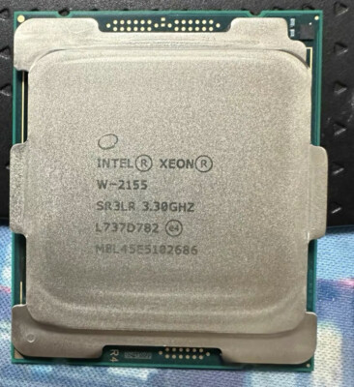
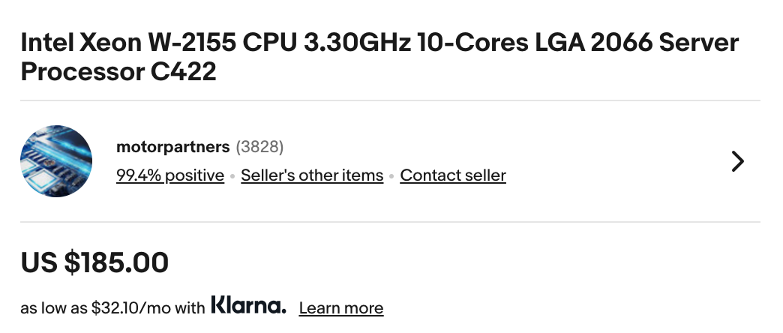
Hardware setup and implementation
Compiled in
g++ 7.5.0
with -O3 flag (highly optimized)
OpenMP enabled (multi-platform shared memory)
www.ebay.com
Some fun facts
STL priority queue suffices due to low scheduling workload (#P << #V)
Buckets implemented using GraphIt’s parallel vector structure (dynamic-sized and contiguous-memory)
METIS used for partitioning
10-core Intel Xeon W-2155 CPU (hyperthreading disabled)
256GB memory 3.3GHz frequency 13.75MB LLC
(there’s a turbo mode up to 4.5GHz)

Slide 24
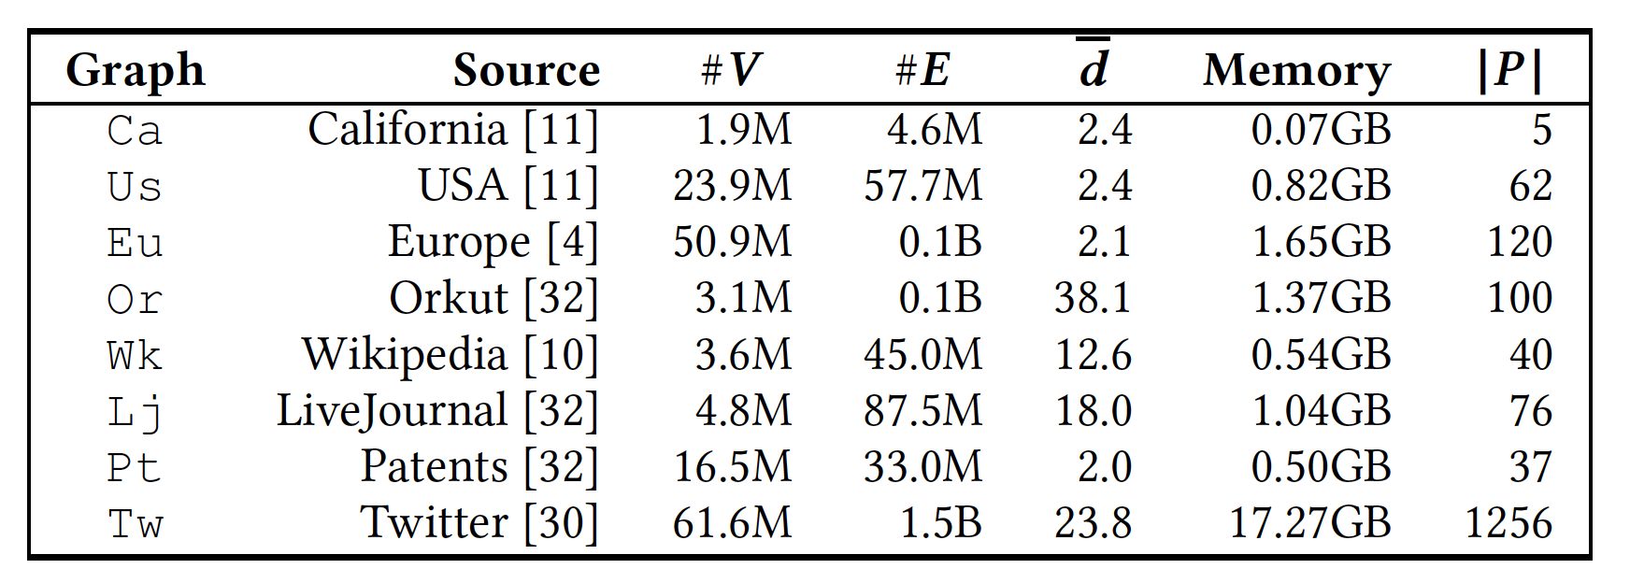
Graphs tested
Road networks
Social Networks
Hyperlink network
Citation network

Slide 25
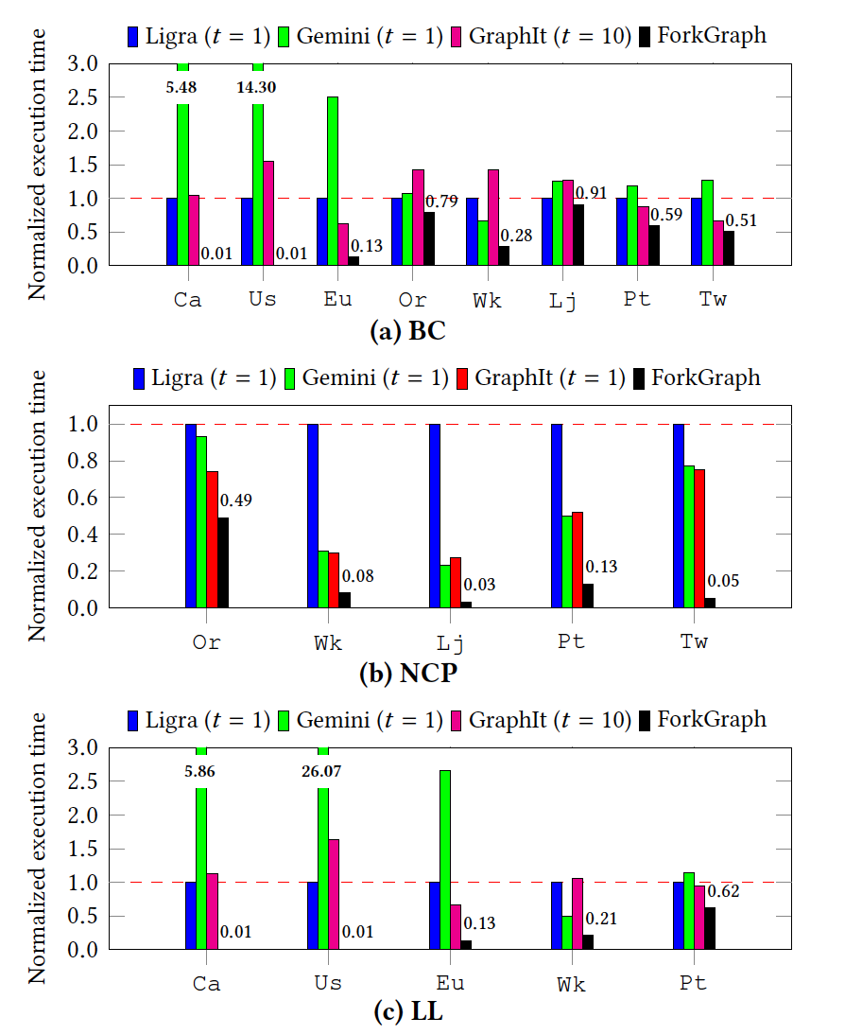
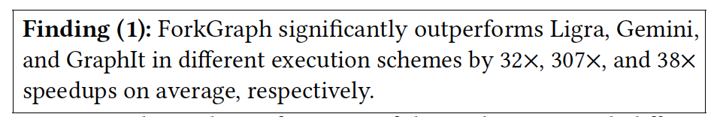
Overall performance
Accelerates convergence within partitions with low cache thrashing and uses sequential algorithms for work-efficiency
Gemini is hamstrung by message-passing materialization overhead (even if message-passing is disabled)
GraphIt does better with more threads (despite being optimized for single-query cache usage) because LLC misses overwhelm the advantages of inter-query parallelism.

Slide 26
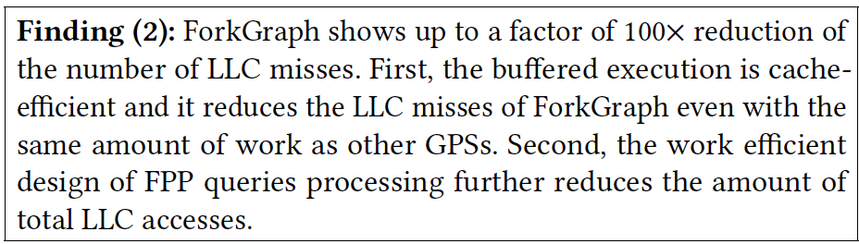
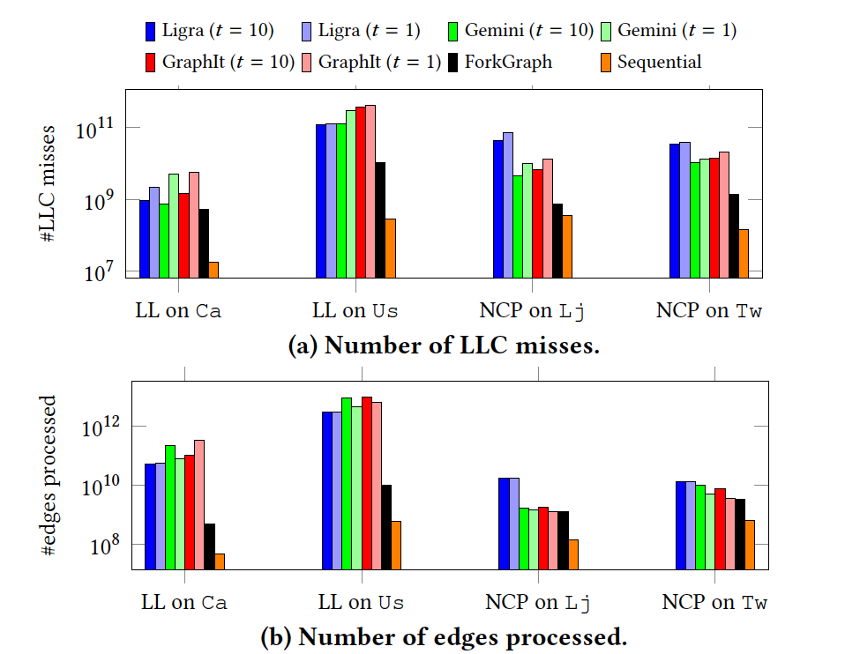
Cache performance
Reduces LLC misses by factor of up to 100x for t=1 and up to 60x for t=10
Only processes 10.4-16.7x more edges on BC, LL than Dijkstra’s algorithm (sequential) and 5.2-9.4x more edges on NCP than sequential
Similar work on Lj and Tw but fewer cache misses makes it significantly faster

Slide 27
Bonus findings
20% of time spent on memory stalls vs >34% by other GPS
Scalable (7-8x speedup from 1 to 10 cores, and high throughput even with additional FPP queries)
METIS partition up to 14.1x faster than random partition, 4.2x faster than GraphIt lightweight partition
LLC-sized partitions tend to perform best (too big and you exceed cache, too small and you incur a large scheduling overhead)

Slide 28
Questions
For Julian: Did Ligra end up implementing ForkGraph?
ForkGraph is designed for a single multicore node, how does it scale to distributed memory environments? What happens when each partition has its own node and own cache? Does coordinating the partitions and buffers over the network negate the cache-efficiency gains?
What happens when two FPP queries are interdependent?
It only seems applicable to certain kinds of FPP algorithms that can be expressed as sequences of small operations (e.g. BFS). What if you try to do multiple algorithms together (e.g. BFS + PPR)? Or need to perform triangle counting?
Dependence on heuristics is concerning and might not translate to other hardware systems.

